Slide 1
Precision Strike
Bring the cheap bazookas to the next level

Slide 2
Current rocket launcher systems
Guided missiles:
Very expensive
Few use-cases
Active-detection-based targeting systems:
Detectable – tactical disadvantage
Still expensive
Unguided bazookas (kerta sinko)
Very low accuracy

Slide 3
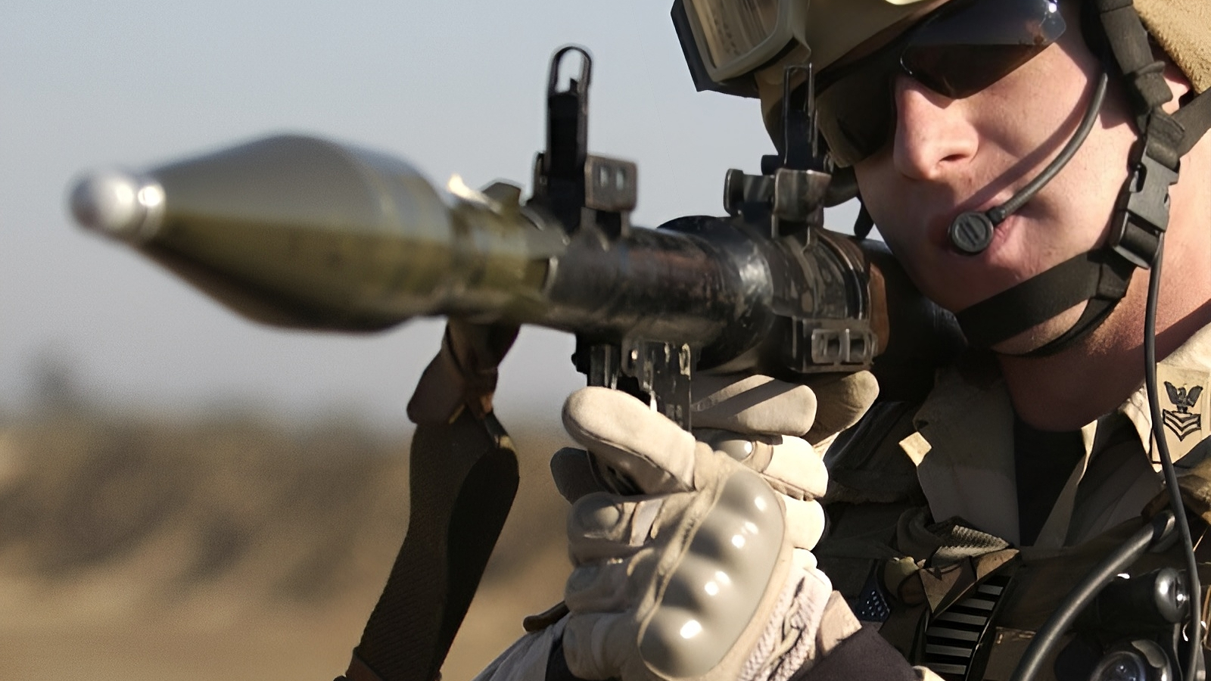
Status quo

Slide 4
Limitations without our solution
Manual estimation of the:
Distance (up to 600m)
Velocity (40-120 km/h)
Difficult target acquisition
Necessity of aim adjustment
Problems:
Low accuracy (10%)
High training costs
Limited applications

Slide 5
Our solution
We use computer vision models to:
Detect and track the targets
Estimate the distance and velocity
We use ballistic calculations to:
Predict where the solider needs to shoot
We increase the accuracy by eliminating the human error in calculation
We reduce the training costs - no need for many practical exercises
We increase the applications - can be used for autonomous devices

Slide 6
Potential customers
National militaries directly
Companies building autonomous weapons
Companies making weapons and optical systems

Slide 7
We made it from scratch!
We wrote the tracking and detection algorithm based on pretrained models
We tested it on laptop with pre-made videos
We implemented the caging for the device
We implemented the AI accelerator chip to boost the performance
We ultra optimised the code to get a smooth video using just the just min-computer (3 to 23 fps change)
We implemented it in the raspberry pi (mini computer) environment
We implemented the live video tracking and detection
We encountered big problems with computational power
We completed the wholly embedded, ready to use device
We completed the testing and filmed the demo

